Slide 1

INFORMATICS & COMPUTATIONAL SCIENCES PROGRAMME VIGYAN BHAWAN BLOCK-A UNIVERSITY COLLEGE OF SCIENCE MOHANLAL SUKHADIA UNIVERSITY, UDAIPUR BACHELOR OF COMPUTER APPLICATION (A Choice Based Credit System)
BCA V Sem
2023-24
(Batch-C)
A
Minor Project Presentation
On
“PRV CARS”
Submitted To: Submitted By:
Dr. Avinash Panwar VISHNU NAIR

Slide 2
Objectives
Facilitate the buying and selling process of used cars
Provide a platform for sellers to reach a wider audience
Offer resources and tools to help potential buyers make informed decisions
Vehicle history reports
Pricing guides
Financing options
Review systems
Create a seamless and secure user experience
Build trust between buyers and sellers
Cater to the diverse needs of the used car market

Slide 3

Introduction
Welcome to our used car selling website! Here, you'll find a wide selection of high-quality pre-owned vehicles, each with detailed descriptions to help you make an informed buying decision. Our goal is to provide you with all the necessary information upfront, so you can confidently find the right car for your needs and budget.
In addition to our detailed descriptions, we also offer vehicle history reports for most of our cars, so you can have a complete picture of the car's past.

Slide 4
Hardware
Specification | System
Processor | Intel i3
OS | Windows 7
RAM | 4GB
ROM | 256GB HDD
Graphics | Not Required

Slide 5

Software
Vs-code / notepad:- You can use Vs-code & notepad for coding. Vs-code give best feature for code the program.
Any browser :- For run the code you must have a browser like chrome, mozilla firefox etc.
Xampp:- XAMPP, which stands for Cross-Platform, Apache, MySQL, PHP, and Perl, is a free platform that allows developers to test their code locally on their own computers. This platform provides the experience of having your own mini web server at home, compatible with both Windows (WAMP) and Linux (LAMP) environments.

Slide 6
Project Module
User Authentication and Registration Module::
Allow users to register for an account or log in using email, phone number, or social media credentials.
Implement authentication mechanisms to ensure secure access to user accounts and personal information.
Messaging and Communication Module:
Enable direct messaging and communication between tenants and landlords for inquiries, property viewing appointments, rental negotiations, and maintenance requests.
Implement real-time chat functionality with message notifications to facilitate timely responses and interactions.
Admin Dashboard and Management Module:
Provide administrators with a centralized dashboard to manage user accounts, property listings, bookings, payments, and site content.

Slide 7
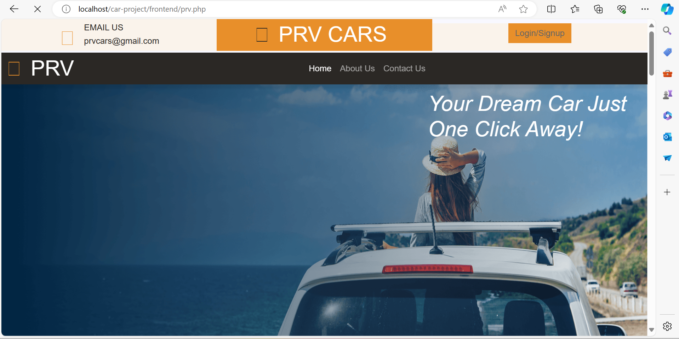
User Panel
This page shown when a user visit the website.

Slide 8
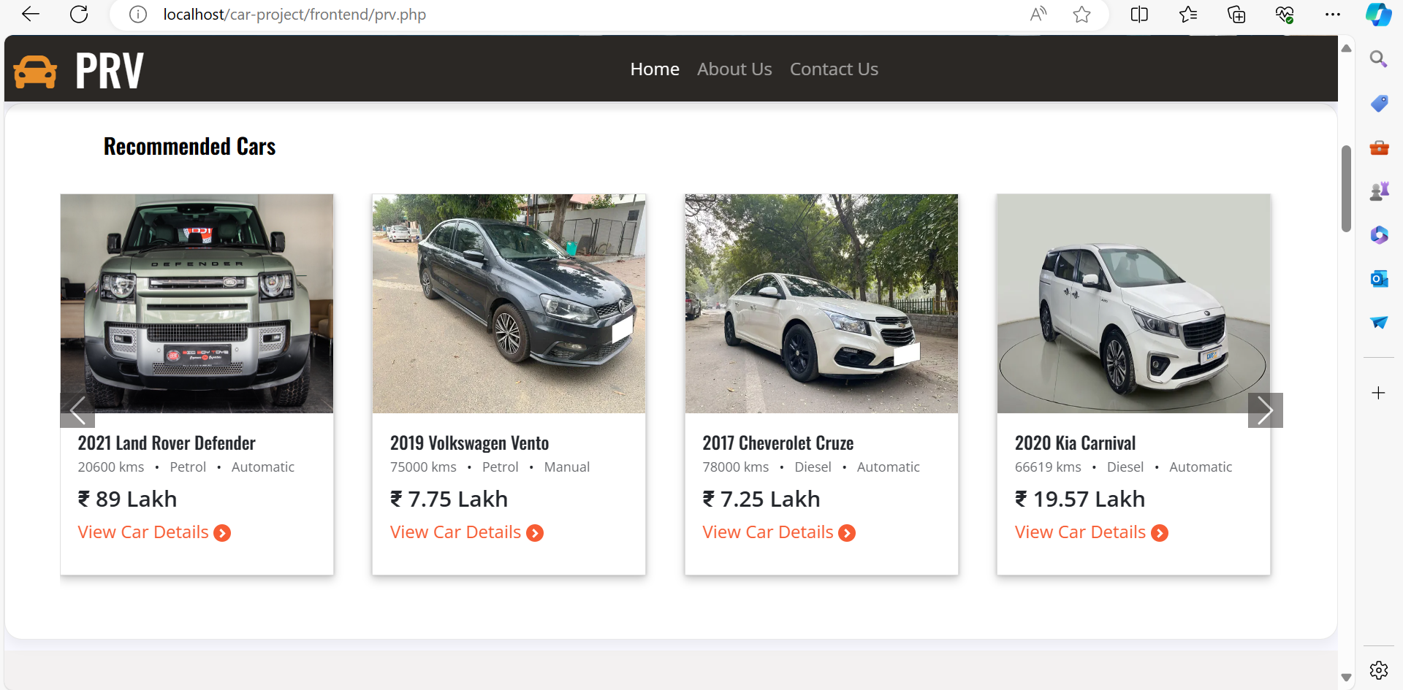
User Panel
This is Recommend Cars Section where cars are shown as per user’s past search.

Slide 9
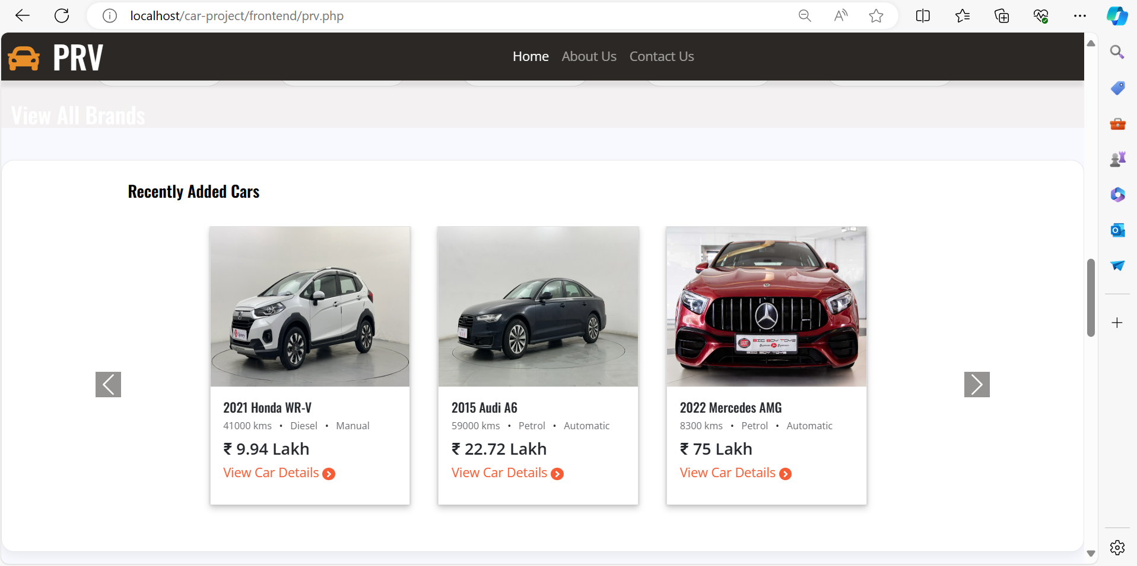
User Panel
This is Recently Added Cars Section where cars are shown to user as admin add in database.

Slide 10
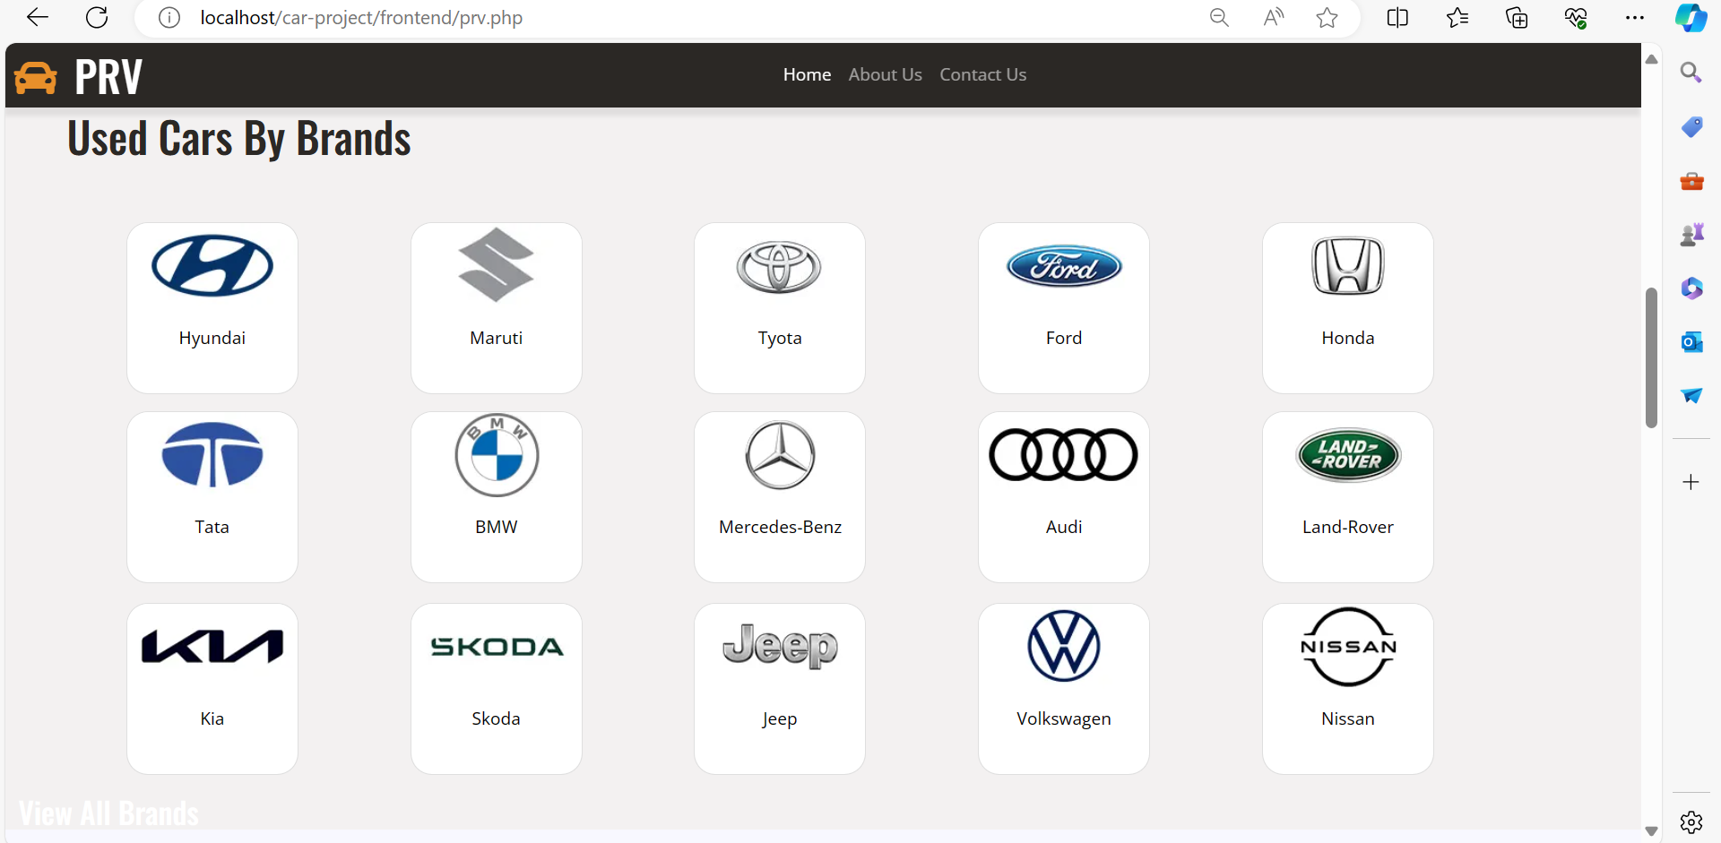
User Panel
This is Used Cars By Brands Section , In this user can search cars by selecting brand

Slide 11
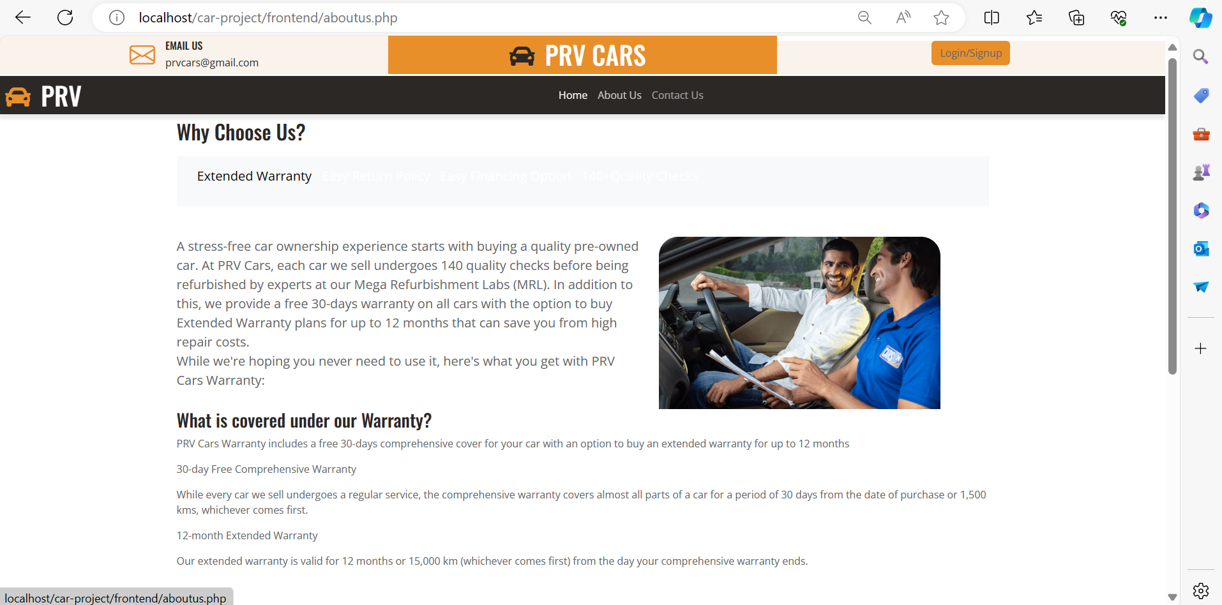
User Panel
This is About Us page .

Slide 12
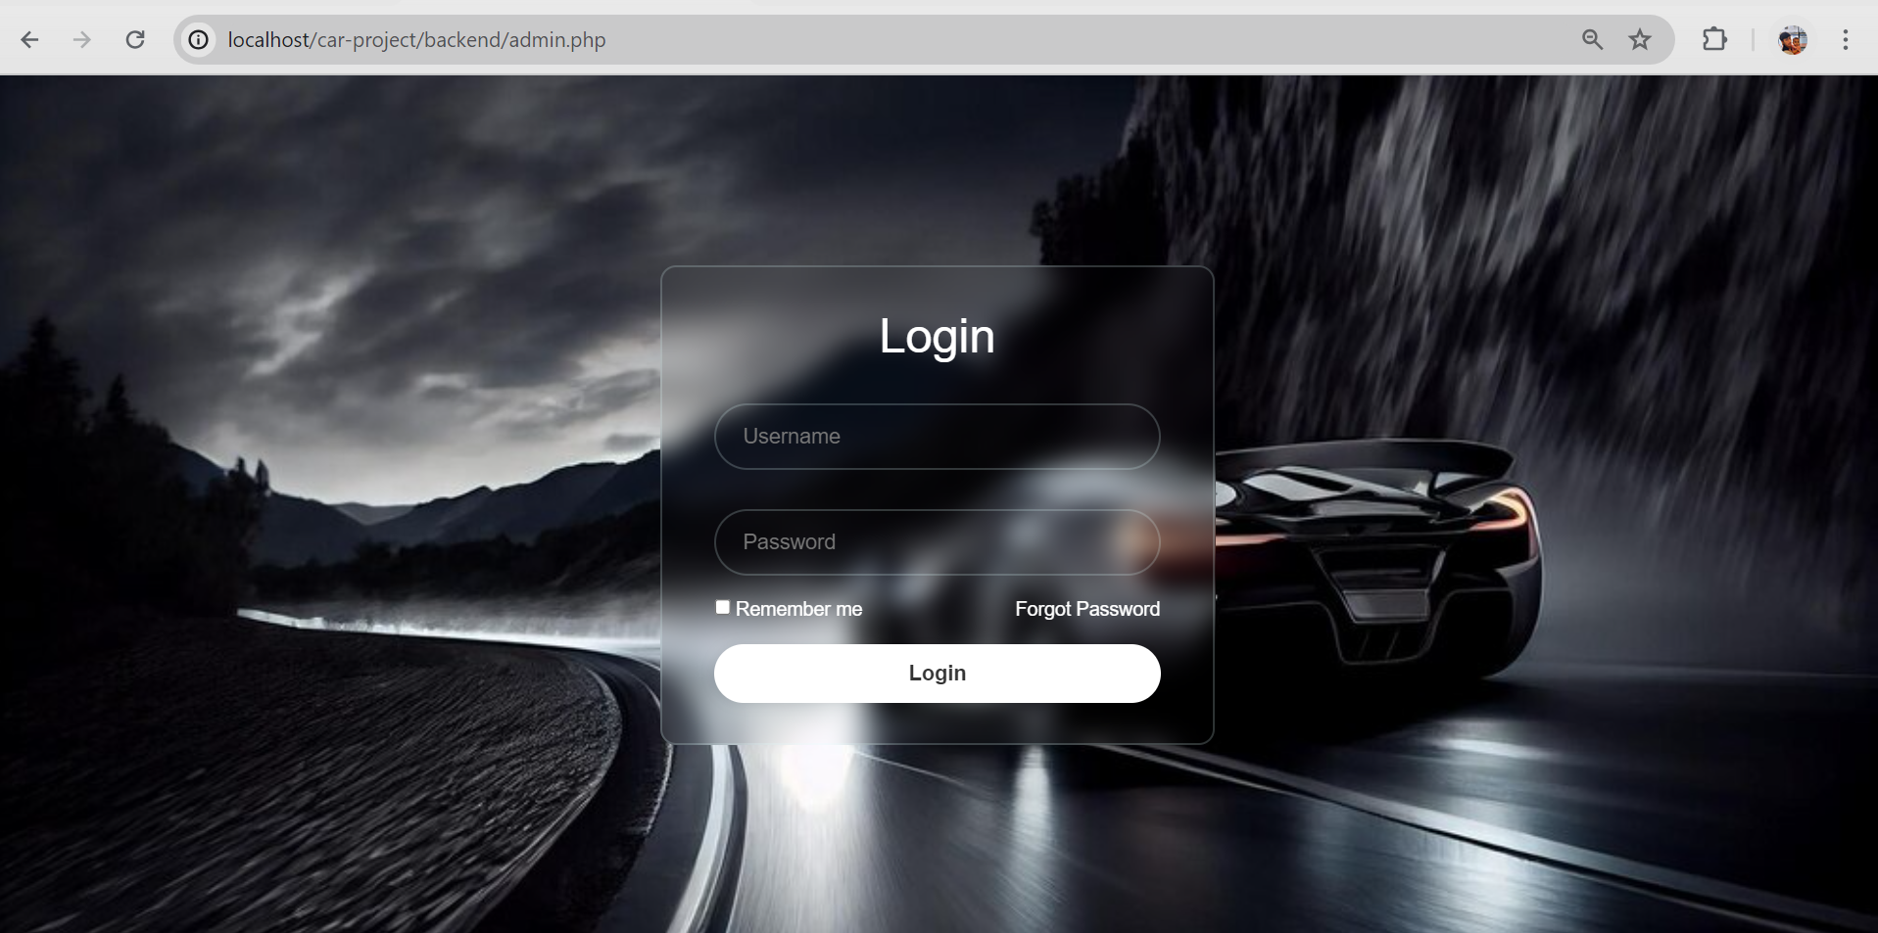
Admin Panel
It’s admin panel’s login page where admin login. Admin login with username and password.

Slide 13
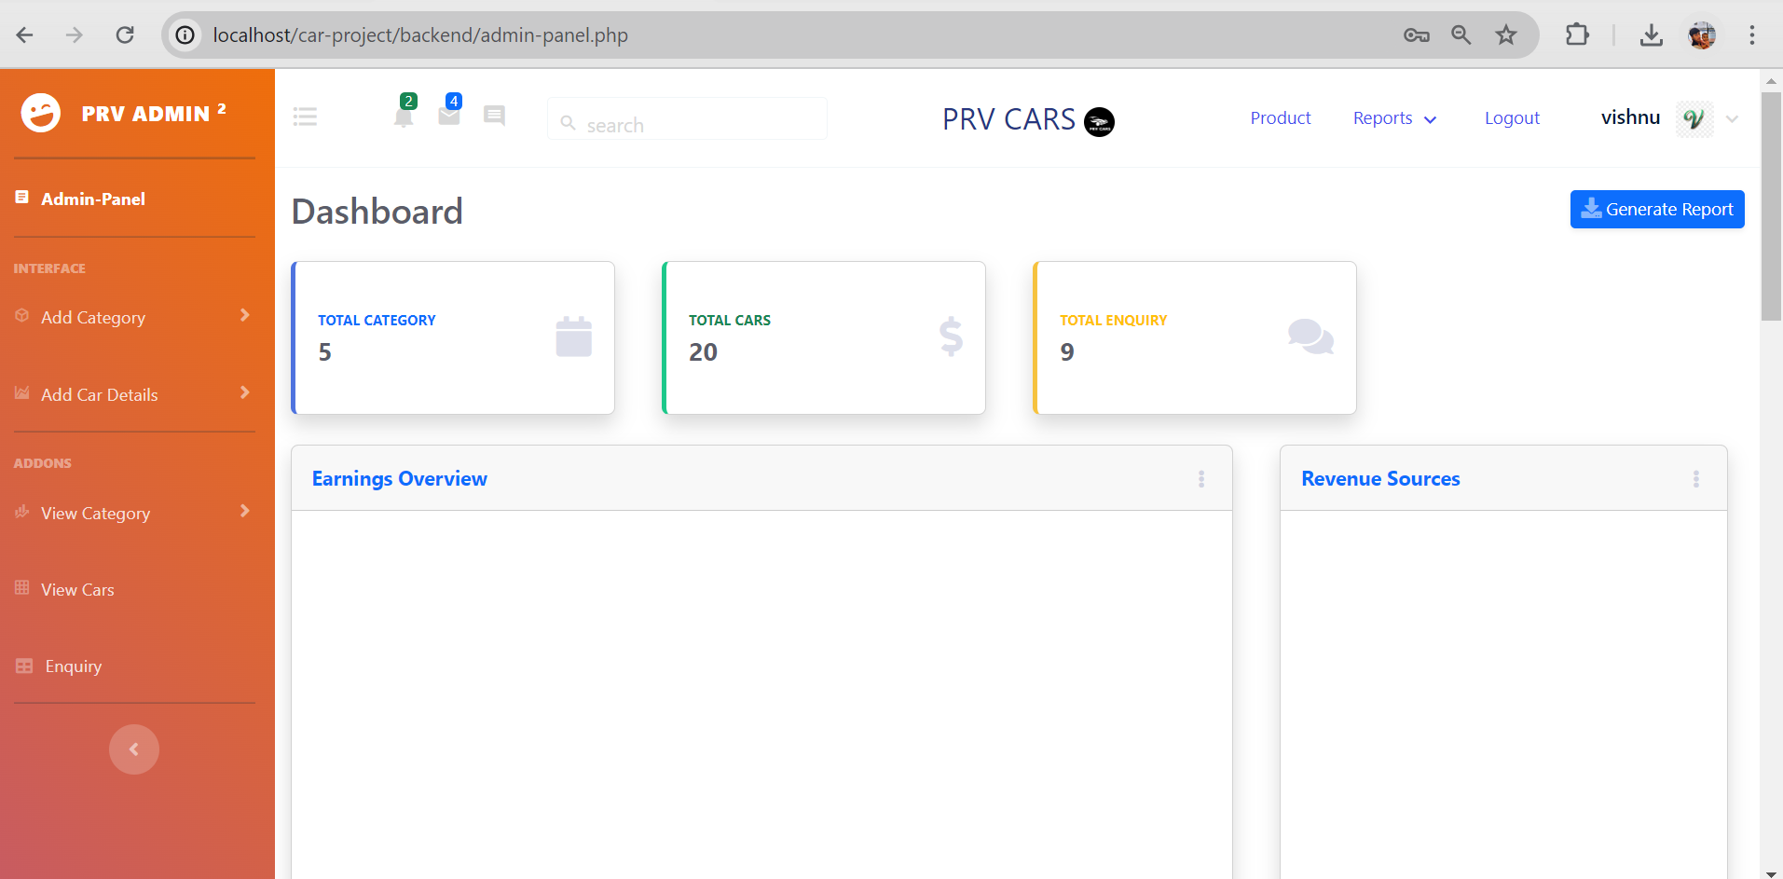
Admin Panel
It’s admin panel’s dashboard. In this we see category, user and all advertisement.

Slide 14
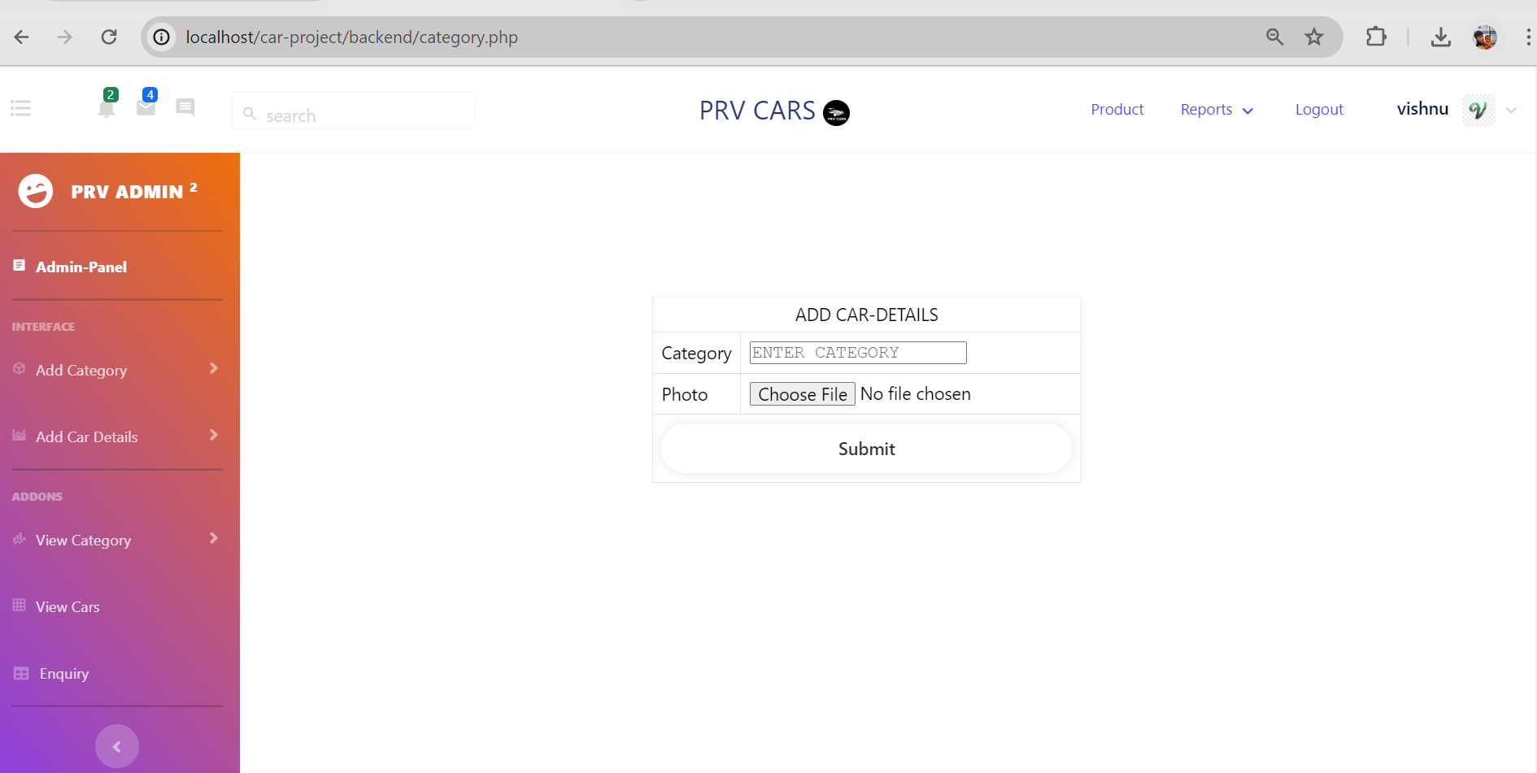
Admin Panel
It’s Admin panel’s Add Category page here we can add category into database.

Slide 15
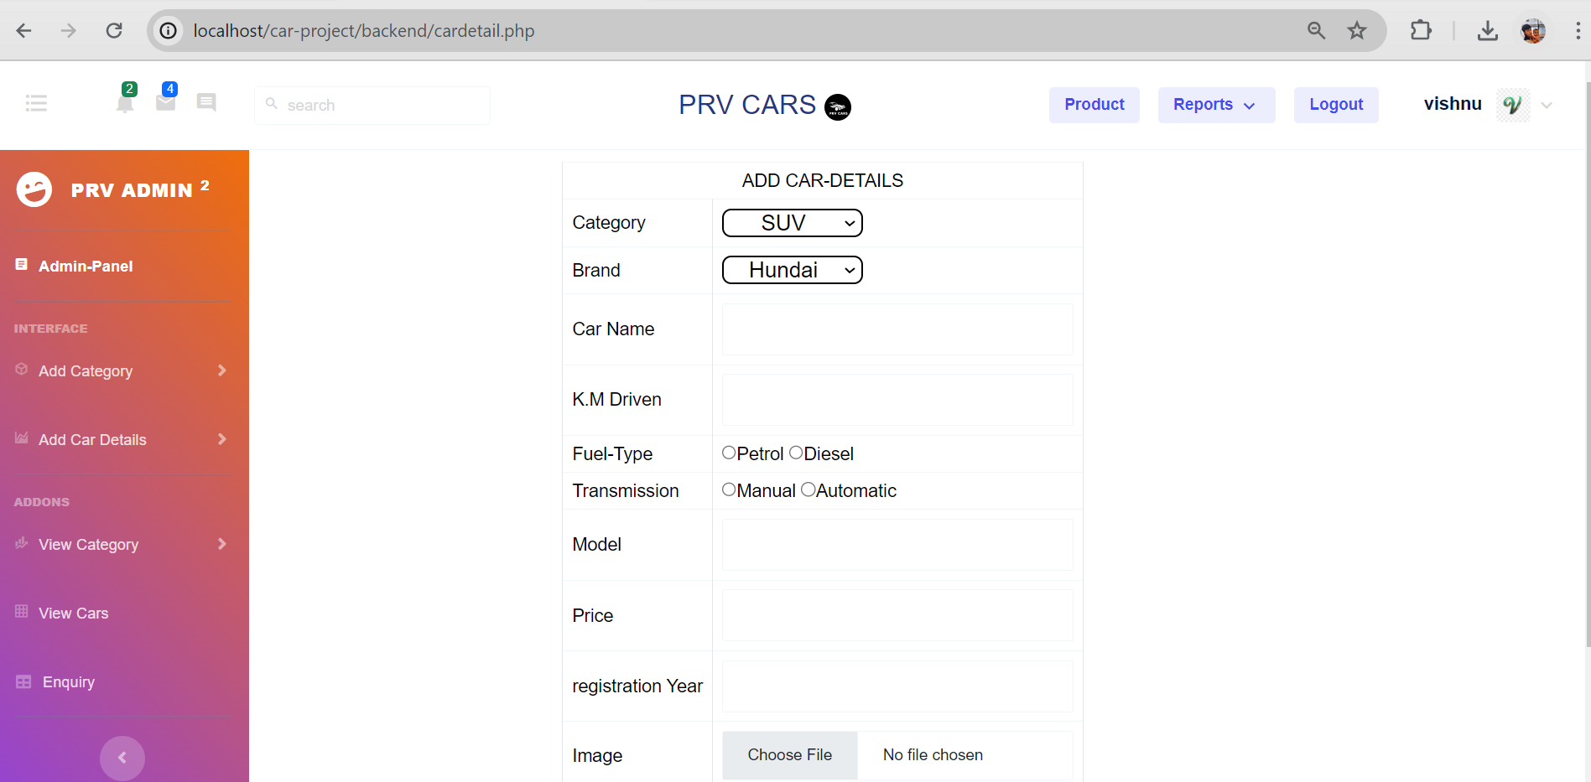
Admin Panel
It’s Admin panel’s Add Car Detail page here we can add car details into database.

Slide 16
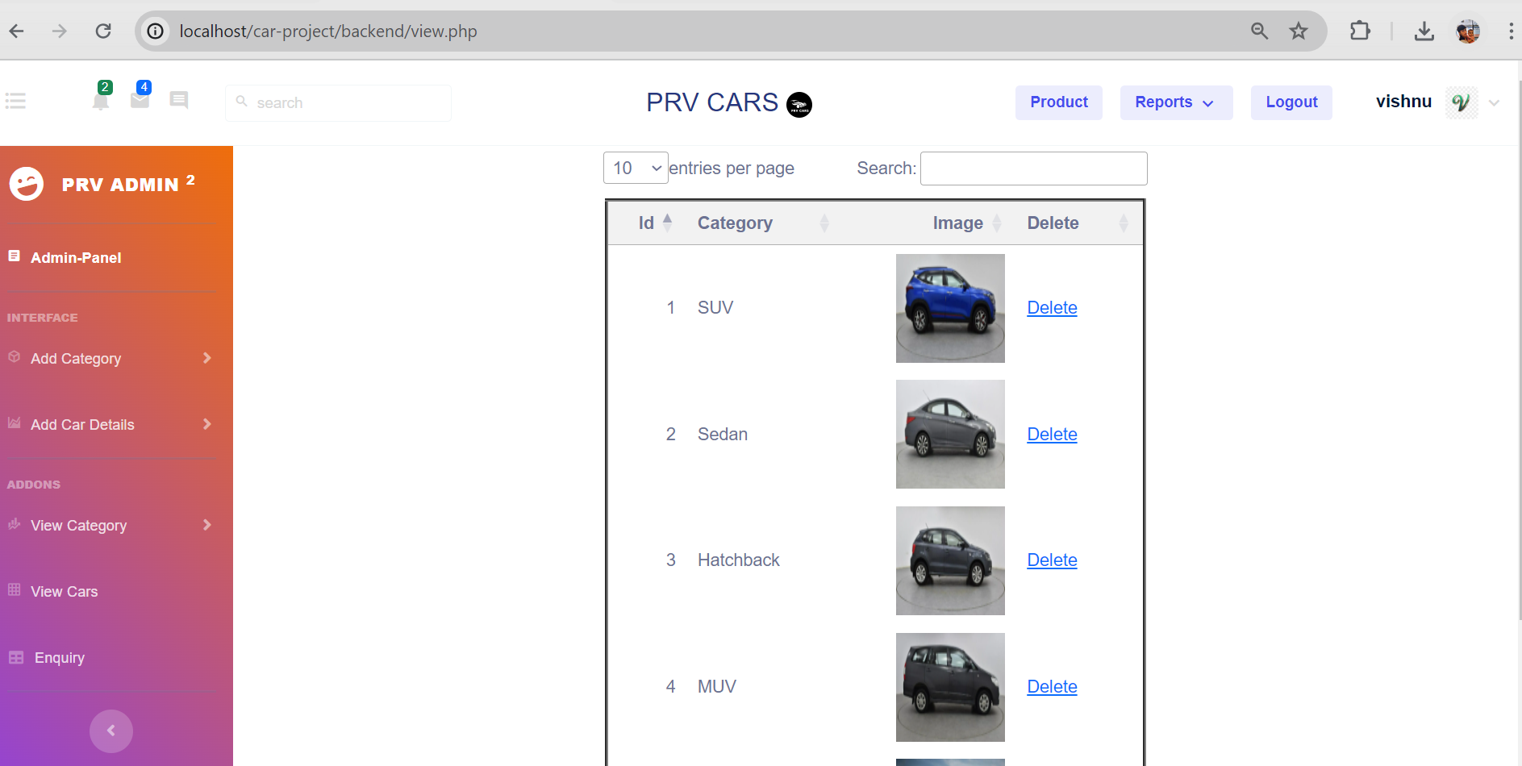
Admin Panel
It’s admin panel’s view category page here we see all category of cars.
Form this page we can remove the category.

Slide 17
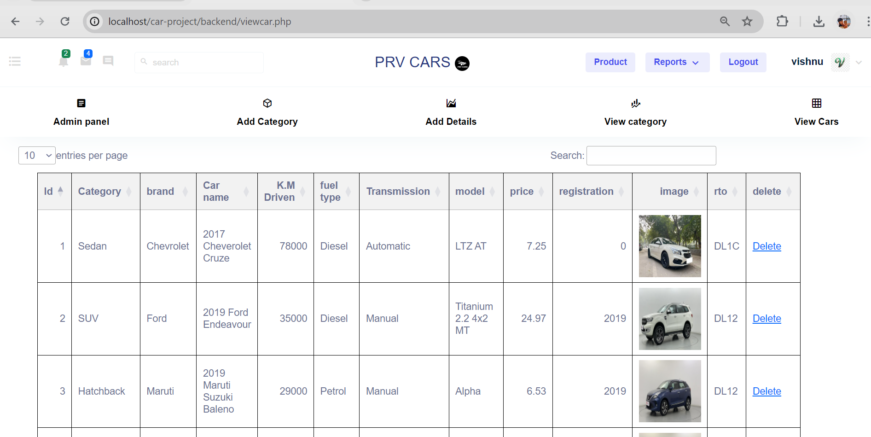
Admin Panel
It’s admin panel’s view car details page here we see all details of cars.
Form this page we can remove the cars.

Slide 18
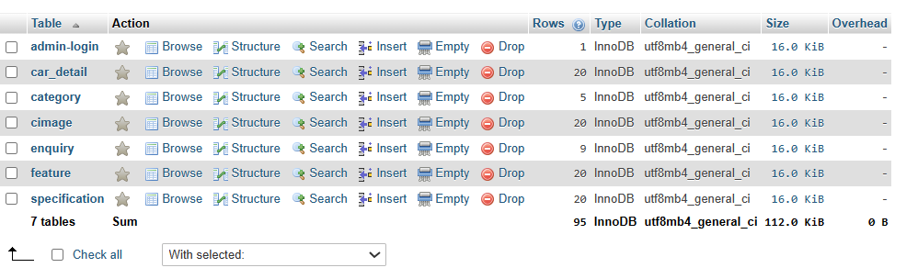
DataBase
This is database of PRV Cars . It contains 7 tables admin-login,car_detail,category,cimage,enquiry,features,specificaton

Slide 19
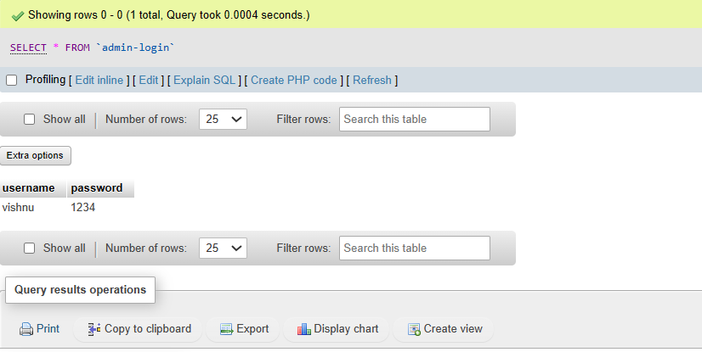
DataBase
It show admin table in this table details of admin users.

Slide 20
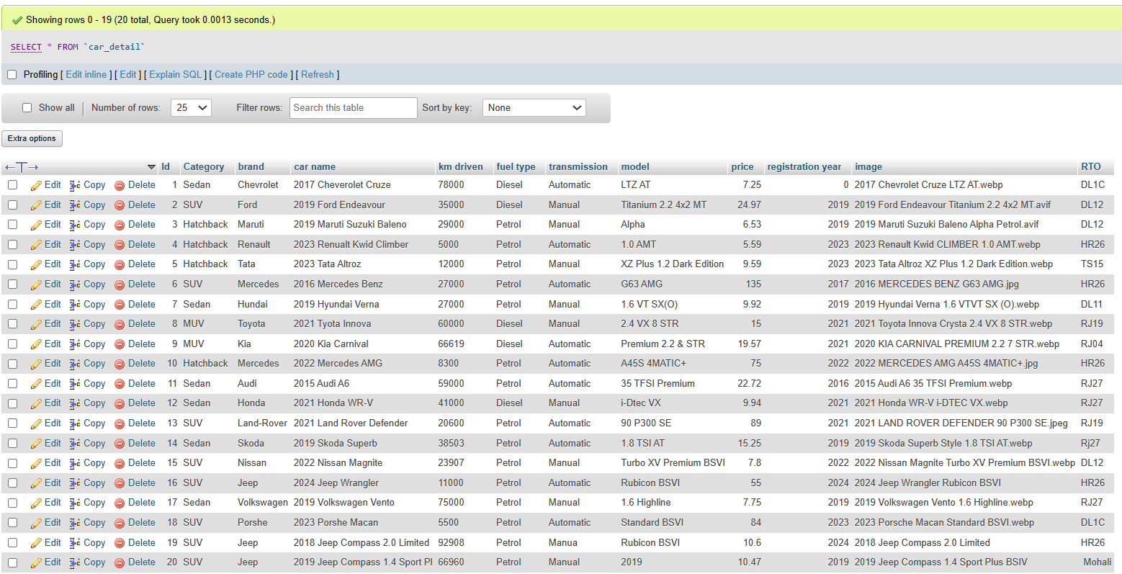
DataBase
This is car detail table in which all details add by admin through backend.

Slide 21
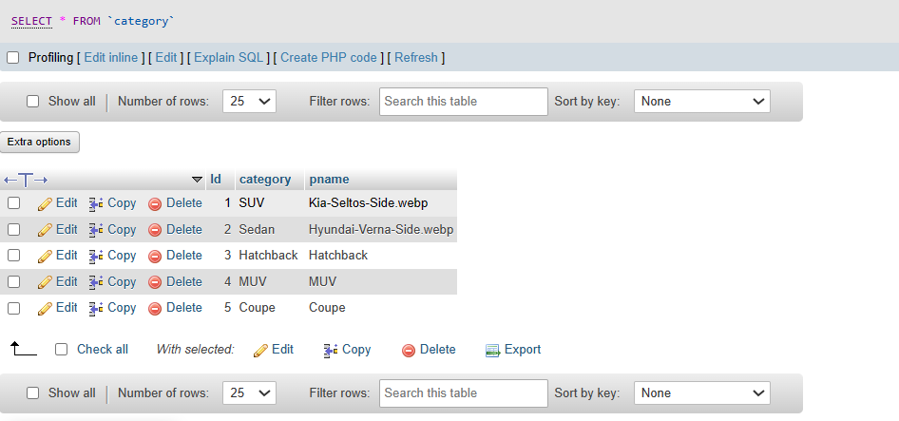
DataBase
This is car category table.It contain All catergory of car.

Slide 22
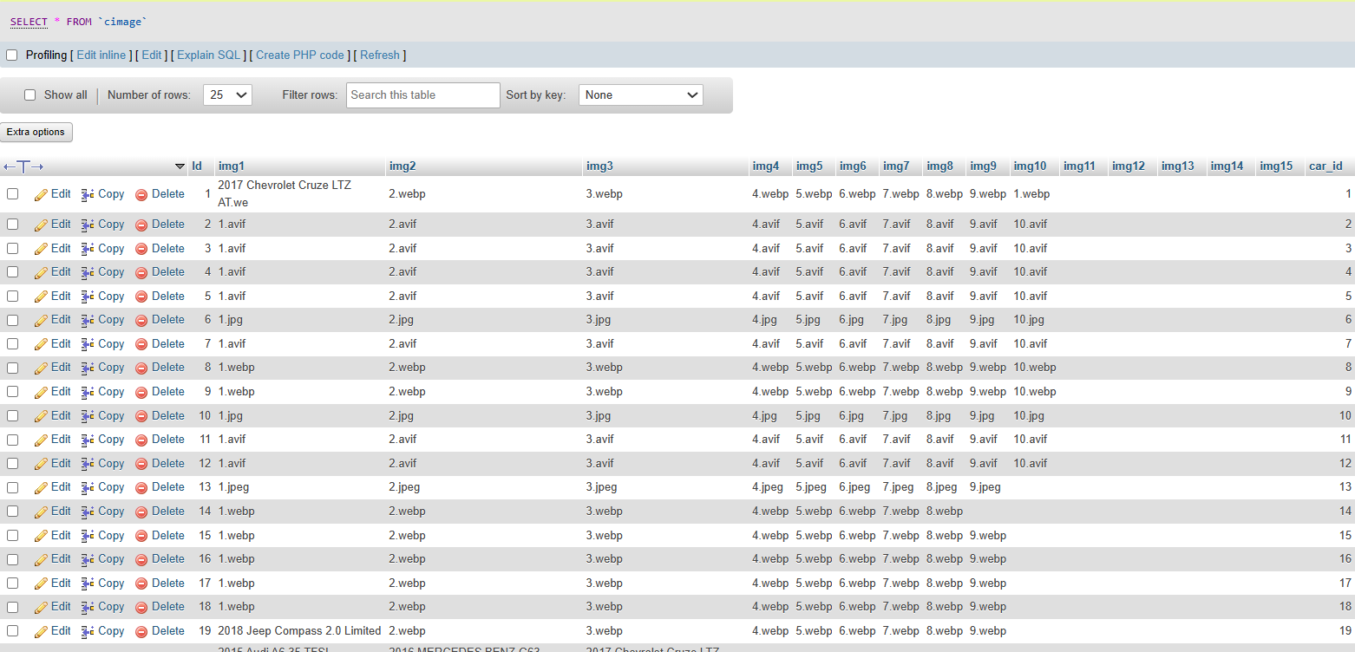
DataBase
This is cimage table.It contain All Images of car.

Slide 23
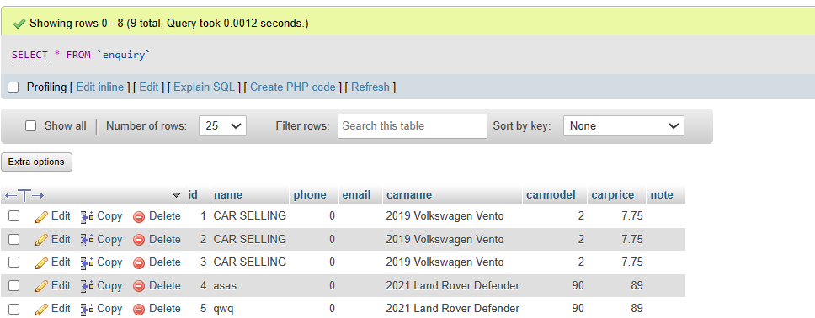
DataBase
This is Enquiry Table. When User fill form and submit it then that data stores in that table.

Slide 24
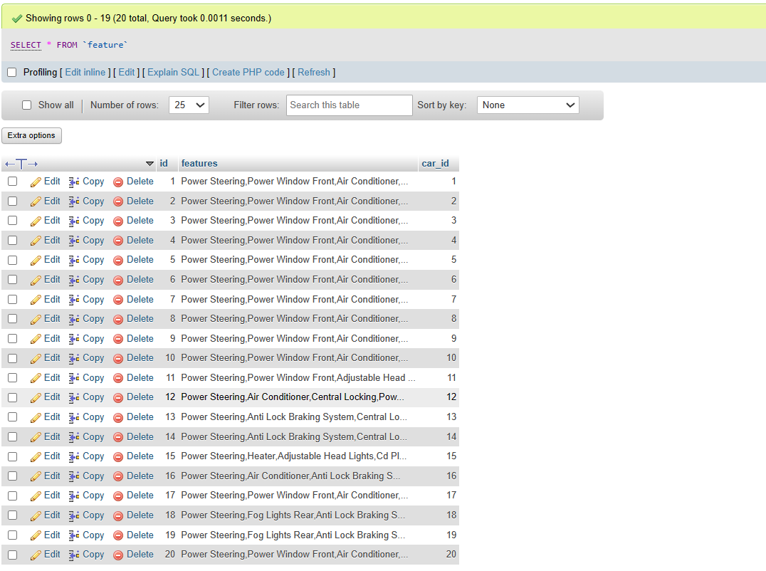
DataBase
This is car Feature table.It contain All features of car.

Slide 25
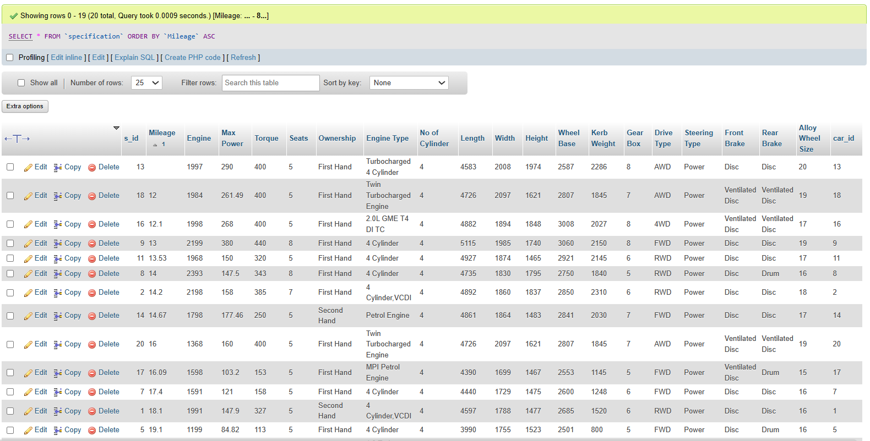
DataBase
This is car specification table.It contain All Specificatons details of car.

Slide 26
Conclusion
Thank you for choosing PRV Cars as your trusted destination for second-hand cars. We've been honored to guide you through the process of finding your perfect vehicle, and we're committed to continuing our support long after your purchase.
At PRV Cars, we're not just selling cars; we're building relationships. Your satisfaction is our top priority, and we'll go above and beyond to ensure that your experience with us exceeds your expectations.
Thank you for putting your trust in us. We look forward to serving you again in the future and helping you find your next dream car.
Drive safely, and welcome to the PRV Cars family!

Slide 27
Biblography
Geeks for Geeks
JavatPoint
Youtube
W3schools
https://www.cardekho.com/
https://www.cars24.com/

